Slide 1
Vector FPU
Ruei-Yuan (2019/6/12)

Slide 2
Vector FPU
Support 16-bit (half-precision), 32-bit (single-precision) operations
Support vector/scalar floating-point instructions
Fix latency for the vector/scalar floating-point instructions

Slide 3
Vector FPU

Slide 4
Vector FPU per Lane (64-bit)
32’b0 or {16’b0, [63:48]}
32/16-bit FPU pipeline
32’b0 or {16’b0, [63:48]}
32’b0 or {16’b0, [47:32]}
32/16-bit FPU pipeline
32’b0 or {16’b0, [47:32]}
[63:32] or {16’b0, [31:16]}
32/16-bit FPU pipeline
[63:32] or {16’b0, [31:16]}
[31:0] or {16’b0, [15:0]}
32/16-bit FPU pipeline
[31:0] or {16’b0, [15:0]}

Slide 5
Vector FPU Pipeline
32
32/16-bit FMAC Pipeline
32/16-bit FPU MISC/CVT Pipeline
32/16-bit FPU DIV/SQRT Pipeline

Slide 6
Vector FPU Interface
input [`VRF_MASK_RANGE] vfxxx_clr_bits;
input [1:0] vfxxx_csr_ediv;
input [`EX_CTRL_RANGE] vfxxx_ex_ctrl;
input [`MOP_CNT_RANGE] vfxxx_mop_cnt;
input [`VRF_MASK_RANGE] vfxxx_msk_bits;
input [2:0] vfxxx_rmode;
input [`DATA_RANGE] vfxxx_rs1_data;
input vfxxx_rs1_valid;
input vfxxx_valid;
input [`CSR_LMUL_RANGE] vfxxx_vtype_lmul;
input [`SEW_RANGE] vfxxx_vtype_sew;
input vfxxx_wide; // indicate the widening operation
output [`VRF_MASK_RANGE] vfxxx_mask;
output [`VRF_DATA_RANGE] vfxxx_data;
output [4:0] vfxxx_vfcsr_flag_set;
Note: xxx includes: mac, div, mis

Slide 7
Vector FPU Pipeline
FPU FMAC pipeline:
ADD/SUB/MUL/MADD/MSUB/REDSUM/DOT instructions
FPU DIV pipeline:
DIV/SQRT instructions
FPU MISC/CVT pipeline:
CMP/MERGE/SIGN/MIN/MAX/CLASS/CVT/REDMAX/REDMIN/MV instructions

Slide 8
FMAC Pipeline
V2
VF1
sub
VF2
VF3
op1
HA
sum
Hidden1
Gen
MUL
3:2
CSA
Sum
op2
HA
carry
op1
unpacked
op2
HA
carry
Carry
op3
Stick
Calc.
St1
St1
INV
71-bits Alignment Shift
CLZ pos
op3
Hidden1
Gen
LZA
CLZ neg
exp1
SHIFT
Amount
Calc.
Sign-detection
exp2
exp3

Slide 9
FMAC Pipeline
VF2
VF3
VF4
5-bit adder
St1
Sum
Normalization Shifter
<<
4-bit low part adder
5-bit adder
Carry
LZA
St1
sign
rounding mode
Subnorm
EXP
LSB-adder
Carry and stick Calc.
Round Decision
LSB-adder
LSB-adder
inc
ovf
LSB Correction & special value detection
Dual-adder
Result
Select
decision
EXP result
Result

Slide 10
DIV Pipeline
V2
VF1
VF2
VF3
Vector
Register
file
op1
Subnormal detection & normalization
div_op1
Divider
result0
op2
div_op2
result1
FSM
V2
VF1
div_op1
op1
Subnormal normalization
Subnormal detection
div_op2
op2
Subnormal normalization
Subnormal detection

Slide 11
DIV Pipeline
VF2
VF3
VF4
remainder0
rounding mode
adder & stick Gen.
Round & Stick
remainder1
Round Decision
quotient_sel
quotient0
Subnormal Shifter
>>
quotient1
special value
detection
result
Result+1
exp
Special Value Detection

Slide 12
Convert Instructions
Conversion between FP and Integer
Integer to FP
16-bit integer to SP/HP
Word integer to SP/HP
FP to Integer
HP to 16-bit/Word integer
SP to 16-bit/Word integer
FP to FP
SP ⬄ HP
HP ⬄ SP
Bfloat ⬄ SP

Slide 13
Integer to FP (1/)
bit
43 | 42 | 41 |  |  | … |  |  | 32 | 31 | 30 | 29 | 28 | 27 | 26 | 25 | 24 | 23 | 22 | 21 | 20 | 19 | 18 | 17 | 16 | 15 | 14 |  |  |  | … |  |  |  | 2 | 1 | 0
23 | 22 | 21 |  |  |  |  |  |  | 11 | 10 | 9 | 8 | 7 | 6 | 5 | 4 | 3 | 2 | 1 | 0L | R | [ |  |  |  |  |  |  |  | S |  |  |  |  |  | ]
Perform two’s complement when input is negative
Source is Word: bit[43:0]={12’b0, int_num[31:0]}
Word to SP/HP: rd_exp=31
Source is 16-bit: bit[43:0]={12’b0, int_num[15:0], 16’b0}
16-bit to SP/HP: rd_exp=15
Source is 8-bit: bit[43:0]={12’b0, int_num[7:0], 24’b0}
8-bit to HP: rd_exp=7
12-bit
Word operand
16-bit operand
8-bit operand
SP
HP
FP format

Slide 14
Integer to FP (2/)
bit
43 | 42 | 41 |  |  | … |  |  | 32 | 31 | 30 | 29 | 28 | 27 | 26 | 25 | 24 | 23 | 22 | 21 | 20 | 19 | 18 | 17 | 16 | 15 | 14 |  |  |  | … |  |  |  | 2 | 1 | 0
23 | 22 | 21 |  |  |  |  |  |  | 11 | 10 | 9 | 8 | 7 | 6 | 5 | 4 | 3 | 2 | 1 | 0L | R | [ |  |  |  |  |  |  |  | S |  |  |  |  |  | ]
Normalization:
Count leading zero of bit[31:0] (LZD) (rd_exp’=rd_exp- lzd)
Left shift 12 bits if target is SP
Left shift bit[43:0] by lz_num[4:0] (5 level mux)
Rounding: (25-bit adder needed: bit[44:20])
Detect Sticky bit (st) (| bit[19:0])
According to round mode and st, add 1 on LSB or on Round bit
If bit[44](SP)/bit[32](HP)==1 ➔ exp+1, fraction=0
12-bit
Word operand
16-bit operand
8-bit operand
SP
HP
FP format

Slide 15
FP to Integer
To use smaller rounding adder (25-bit):
Exp<23: rsh (23-exp), Leading 8 bits are 0
need to be rounded (at least 1bit shifted to bit[7:0])
Result integer = {8’b0, bit[31:8]}
23 ≦ Exp ≦ 31: right shift (31-exp),
no need to be rounded
Result integer = {bit[31:0]}
31
8 7 0
8’b0
Round bit
result
31
8 7 0
No rounding is needed
result

Slide 16
FP to 32/16/8 Bit Integer
Right shift by sh_amount
0<exp<23: sh_amount = 23-exp, then rounding by 25bit adder
32bit_int[31:0] ={8’b0,bit[31:8]}
16bit_int[15:0] = bit[23:8]
8bit_int[7:0] = bit[15:8]
exp >= 23: sh_amount = 31-exp, no rounding
32bit_int[31:0]=bit[31:0]
16bit_int: exception
8bit_int: exception
bit
31 | 30 | 29 | 28 |  |  |  |  |  |  |  |  | … |  |  |  |  |  |  |  | 9 | 8 | 7 | 6 | 5 | … | 2 | 1 | 0
23 | 22 | 21 |  |  | S | P |  |  |  |  |  |  |  |  |  |  |  | 3 | 2 | 1 | 0
10 | 9 | 8 | 7 | 6 | H | P | 3 | 2 | 1 | 0
 |  |  |  |  |  |  |  |  |  |  |  |  |  |  |  |  |  |  |  |  | L | R | [ |  | S |  |  | ]
To Rounding 25-bit Adder

Slide 17
Convert Between SP and HP
SP to HP
Right shift amount:
(31-18=13) + (-exp-13) if target result is subnorm
Rounding (i.e. -13>sp_exp>-25)
HP to SP
bit[31:0] = {hp[10:0],20’b0}
Use LZD to left shift subnormal input
bit
31 | 30 | 29 |  |  |  |  |  |  | 18 |  |  |  |  |  |  |  |  |  | 8 | 7 | 6 | 5 | … | 2 | 1 | 0
23 | 22 | 21 |  |  |  |  |  |  |  |  |  |  |  |  |  |  |  |  | 0
 |  |  |  |  |  |  |  |  | 10 | 9 | 8 | 7 | 6 | 5 | 4 | 3 | 2 | 1 | 0 L | R | [ |  | S |  |  | ]
To be Rounded in 25-bit Adder

Slide 18
Convert Between SP and Bfloat
SP to Bfloat
Right shift by 31-15=16 bit (do not detect subnormal)
Rounding
Bfloat to SP
sp[31:0] = {bfloat[15:0],16’b0}
bit
31 | 30 | 29 |  |  |  |  |  |  |  |  |  | 15 |  |  |  |  |  |  | 8 | 7 | 6 | 5 | … | 2 | 1 | 0
23 | 22 | 21 |  |  |  |  |  |  |  |  |  |  |  |  |  |  |  |  | 0
 |  |  |  |  |  |  |  |  |  |  |  | 7 | 6 | 5 | 4 | 3 | 2 | 1 | 0 L | R | [ |  | S |  |  | ]
To be rounded in 25-bit Adder

Slide 19
Convert Instructions uArch
Conversion needs Left Shifter
Integer to FP
HP to SP
left shift when subnormal input, otherwise don’t need shifter
Conversion needs Right Shifter
FP to Integer
SP to HP
SP to Bfloat

Slide 20
uArch of Convert Instructions
FP2Int/FP Path
Int2FP/HP2SP Path
Shift amount
2’s comp.
FP1
Alignment (Right shifter)
Normalization (Left shifter)
LZD
…
st0
st1
rounding_mode
Round digit gen
instr_type
FP2
25-bit adder
no_round
sign
2’s complement
F2I result
I2F/F2F result

Slide 21
Reduction Sum Operation (Unordered) per Lane (64-bit)
FMAC pipe3
Vs2[3]
FMAC pipe2
FMAC pipe2
Vs2[2]
FMAC pipe0
FMAC pipe1
Vs2[1]
FMAC pipe0
FMAC pipe0
Vs2[0]
Vs1[0]
4T
4T
4T

Slide 22
Reduction Sum Operation (Unordered) per Lane
Operation: vd[0] = sum( vs2[*] , vs1[0] )
Lane0 | Result(T0) | Result(T1) | Result(T2)
pipe0 | Vs1[0]+Vs2[0] | P0_T0+Vs2[1] | P0_T1+P2_T1
Pipe1 | x | x | x
Pipe2 | Vs2[2]+Vs2[3] | Vs2[2]+Vs2[3] (hold the result) | x
Pipe3 | X | x | x
LMUL=1, T= 4 cycles

Slide 23
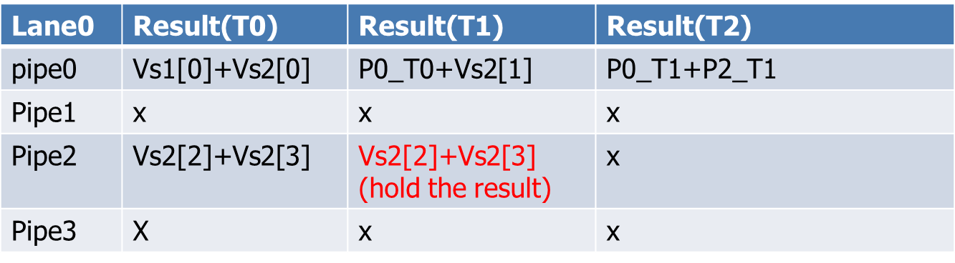
Reduction Sum Operation per Lane (T0)
Reduction control
V2 stage
FMAC pipeline3
op1
op3
Vs2[2]
FMAC pipeline2
op1
Vs2[3]
op3
FMAC pipeline1
op1
op3
Vs2[0]
FMAC pipeline0
Vs1[0]
op1
op3

Slide 24
Reduction Sum Operation per Lane (T1)
Reduction control
Vs2[3]
FMAC pipeline3
op1
op3
Vs2[2]
FMAC pipeline2
op1
Vs2[3]
op3
FMAC pipeline1
op1
op3
Vs2[1]
FMAC pipeline0
Vs2[0]+Vs1[0]
op1
op3

Slide 25
Reduction Sum Operation per Lane (T2)
Reduction control
FMAC pipeline3
op1
op3
Vs2[2]
FMAC pipeline2
Vs2[2]+Vs2[3]
op1
Vs2[3]
op3
FMAC pipeline1
op1
op3
FMAC pipeline0
Vs2[1]+Vs2[0]+Vs1[0]
op1
op3

Slide 26
Reduction Sum Operation per Lane (T3)
Reduction control
FMAC pipeline3
op1
op3
FMAC pipeline2
op1
op3
FMAC pipeline1
op1
op3
FMAC pipeline0
op1
op3
Vs2[2]+Vs2[3]
Vs2[1]+Vs2[0]+Vs1[0]

Slide 27
Reduction Sum Operation (Unordered) per Lane
Operation: vd[0] = sum( vs2[*] , vs1[0] )
Lane0 | Result(T0) | Result(T1) | Result(T2)
pipe0 | V4[0]+V8[0] | P0_T0+V5[0] | P0_T1+V6[0]
Pipe1 | x | V4[1]+V5[1] | P1_T1+V6[1]
Pipe2 | x | V4[2]+V5[2] | P2_T1+V6[2]
Pipe3 | x | V4[3]+V5[3] | P3_T1+V6[3]
LMUL>1, T= 4 cycles, e.g.: LMUL=4, and Vs2=V4,V5,V6,V7 and Vs1=V8

Slide 28
Reduction Sum Operation (Unordered) per Lane
Operation: vd[0] = sum( vs2[*] , vs1[0] )
Lane0 | Result(T3) | Result(T4) | Result(T5)
pipe0 | P0_T2+V7[0] | P0_T3+P1_T3 | P0_T4+P1_T4
Pipe1 | P1_T2+V7[1] | x | x
Pipe2 | P2_T2+V7[2] | P2_T3+P3_T3 | x
Pipe3 | P3_T2+V7[3] | x | x
LMUL>1, T= 4 cycles, e.g.: LMUL=4, and Vs2=V4,V5,V6,V7 and Vs1=V8

Slide 29
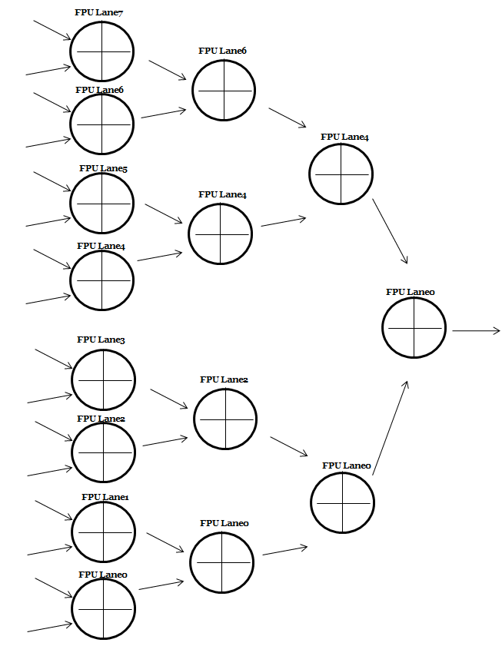
Reduction Sum Operation (Unordered)
Vs2[N]
Vs1[N]
.
.
.
Vs2[1]
Vs1[0]
4T*LMUL+8T
4T
4T
4T

Slide 30
Reduction Sum Operation (Unordered) for Lane
 | Result(T0) | Result(T1) | Result(T2) | Result(T3)
Lane0 | L0_T0 | L0_T0+L1_T0 | L0_T1+L2_T1 | L0_T2+L4_T2
Lane1 | L1_T0 | x | x
Lane2 | L2_T0 | L2_T0+L3_T0 | x
Lane3 | L3_T0 | x | x
Lane4 | L4_T0 | L4_T0+L5_T0 | L4_T1+L6_T1
Lane5 | L5_T0 | x | x
Lane6 | L6_T0 | L6_T0+L7_T0 | x
Lane7 | L7_T0 | x | x
LMUL>=1, T0= 4*LMUL + 8 cycles, T1, T2, T3 = 4 cycles

Slide 31
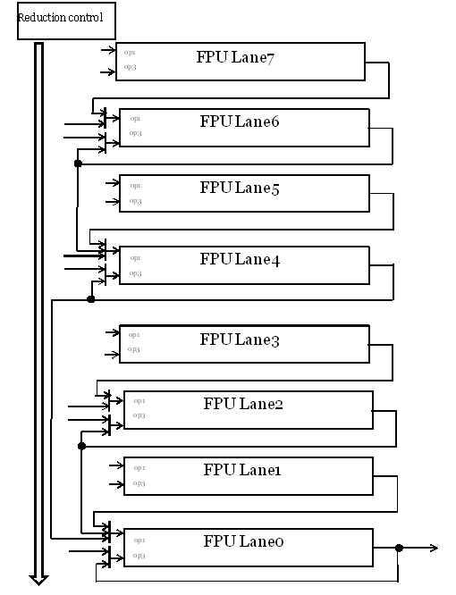
Reduction Sum Operation (Lane Top)

Slide 32
Reduction Sum Operation (step1 * LMUL)

Slide 33
Reduction Sum Operation (step 2)

Slide 34
Reduction Sum Operation (step 3)

Slide 35
Reduction Sum Operation (step 4)

Slide 36
Reduction Sum (Unordered) Instructions Latency
Instruction | Latency
Reduction sum (unordered) | ((Log2(elements)*4) + 4)*LMUL 4*LMUL+4*(log2(512/SEW))

Slide 37
Reduction Sum Operation (Ordered)
Reuse the unordered logic for the reduction sum ordered operation.

Slide 38
Reduction Sum Operation per Lane
Reduction control
Vs2[3]
FMAC pipeline3
op1
op3
Vs2[2]
FMAC pipeline2
op1
op3
Vs2[1]
FMAC pipeline1
op1
op3
Vs2[0]
FMAC pipeline0
Vs1[0]
op1
op3

Slide 39
Reduction Sum Operation per Lane
Reduction control
Vs2[3]
FMAC pipeline3
op1
op3
Vs2[2]
FMAC pipeline2
op1
op3
Vs2[1]
FMAC pipeline1
op1
op3
Vs2[1]
FMAC pipeline0
Vs1[0] + Vs2[0]
op1
op3

Slide 40
Reduction Sum Operation per Lane
Reduction control
Vs2[3]
FMAC pipeline3
op1
op3
Vs2[2]
FMAC pipeline2
op1
op3
Vs2[1]
FMAC pipeline1
op1
op3
Vs2[2]
FMAC pipeline0
Vs1[0] + Vs2[0]+Vs2[1]
op1
op3

Slide 41
Reduction Sum Operation per Lane
Reduction control
Vs2[3]
FMAC pipeline3
op1
op3
Vs2[2]
FMAC pipeline2
op1
op3
Vs2[1]
FMAC pipeline1
op1
op3
Vs2[3]
FMAC pipeline0
Vs1[0] + Vs2[0]+Vs2[1]+Vs2[2]
op1
op3

Slide 42
Reduction Sum Operation per Lane
Reduction control
Vs2[3]
FMAC pipeline3
op1
op3
Vs2[2]
FMAC pipeline2
op1
op3
Vs2[1]
FMAC pipeline1
op1
op3
FMAC pipeline0
Vs1[0] + Vs2[0]+Vs2[1]+Vs2[2]+Vs2[3]
op1
op3

Slide 43
Reduction Sum Operation

Slide 44
Reduction Sum (Ordered) Instructions Latency
Instruction | Latency
Reduction sum (ordered) | 4*(512/SEW)*LMUL

Slide 45
Widening Operation
Convert the all source operand (e.g. 16-bit) to 32-bit (single precision) for the widening operation.
Case1: 2*SEW = SEW + SEW
Case2: 2*SEW = 2*SWE + SEW

Slide 46
Dot Product Operation
Reuse the reduction unordered logic to implement dot product operation.

Slide 47
Dot Product Operation per Lane
Operation: Vd[i] = vd[i] + vs1[i] * vs2[i], sew=32 and ediv=1
Lane0 | Result(T0) | Result(T1)
pipe0 | Vs2[0]*Vs1[0] | P0_T0+Vd[0]
Pipe1 | Vs2[1]*Vs1[1] | P1_T0+Vd[1]
Pipe2 | x | x
Pipe3 | x | x
T= 4 cycles, the latency is 2T = 8
Operation: Vd[i] = vd[i] + vs1[i] * vs2[i], sew=16 and ediv=1
Lane0 | Result(T0) | Result(T1)
pipe0 | Vs2[0]*Vs1[0] | P0_T0+Vd[0]
Pipe1 | Vs2[1]*Vs1[1] | P1_T0+Vd[1]
Pipe2 | Vs2[2]*Vs1[2] | P2_T0+Vd[2]
Pipe3 | Vs2[3]*Vs1[3] | P3_T0+Vd[3]
T= 4 cycles, the latency is 2T = 8

Slide 48
Dot Product Operation per Lane
Operation: Vd[i] = vd[31:0] + (vs1[31:16] * vs2[31:16]) +
(vs1[15: 0] * vs2[15: 0]), sew=32 and ediv=2
Lane0 | Result(T0) | Result(T1) | Result(T2)
pipe0 | Vs2[0][15: 0]*Vs1[0][15: 0] | P0_T0+P1_T0 | P0_T1+Vd[0][31:0]
Pipe1 | Vs2[0][31:16]*Vs1[0][31:16] | x | x
Pipe2 | Vs2[1][15: 0]*Vs1[1][15: 0] | P2_T0+P3_T0 | P2_T1+Vd[0][31:0]
Pipe3 | Vs2[1][31:16]*Vs1[1][31:16] | x | x
T= 4 cycles, the latency is 3T = 12

Slide 49
Dot Product Operation per Lane
Reduction control
Vs2[1][31:16]
FMAC pipeline3
op1
Vs1[1][31:16]
op2
Vs2[1][15:0]
FMAC pipeline2
op1
Vs1[1][15:0]
op2
Vs2[0][31:16]
FMAC pipeline1
op1
Vs1[0][31:16]
op2
Vs2[0][15:0]
FMAC pipeline0
Vs2[0][15:0]
op1
op2

Slide 50
Dot Product Operation per Lane
Reduction control
FMAC pipeline3
op1
Vs2[1][31:16] * Vs1[1][31:16]
op3
FMAC pipeline2
op1
Vs2[1][15:0] * Vs1[1][15:0]
op3
FMAC pipeline1
op1
Vs2[0][31:16] * Vs1[0][31:16]
op3
FMAC pipeline0
Vs2[0][15:0] * Vs1[0][15:0]
op1
op3

Slide 51
Dot Product Operation per Lane
Reduction control
FMAC pipeline3
op1
op3
Vd[1][31:0]
FMAC pipeline2
op1
(Vs2[1][31:16] * Vs1[1][31:16]) +
(Vs2[1][15:0] * Vs1[1][15:0])
op3
Vs2[1]
FMAC pipeline1
op1
0
op3
Vs2[1]
Vd[0][31:0]
FMAC pipeline0
(Vs2[0][31:16] * Vs1[0][31:16]) +
(Vs2[0][15:0] * Vs1[0][15:0])
op1
op3

Slide 52
Dot Product Operation per Lane
Reduction control
FMAC pipeline3
op1
op3
FMAC pipeline2
op1
(Vs2[1][31:16] * Vs1[1][31:16]) +
(Vs2[1][15:0] * Vs1[1][15:0])
+ Vd[1][31:0]
op3
FMAC pipeline1
op1
op3
FMAC pipeline0
(Vs2[0][31:16] * Vs1[0][31:16]) +
(Vs2[0][15:0] * Vs1[0][15:0])
+ Vd[0][31:0]
op1
op3

Slide 53
Instructions Latency
Instruction | Latency
ADD/SUB/MUL/MADD/MUSB | 4 + (LMUL-1)
ADD/SUB/MUL/MADD/MUSB (widening) | 4 + (2*LMUL-1) + 1
DIV/SQRT | 17*LMUL (sew=32, single precision) 10*LMUL (sew=16, half precision)
SGN/CMP/CVT/MAX/MIN/MERGE/MV/CLASS | 2 + (LMUL-1)
DOT (sew=16/32, ediv=1) | 8*LMUL
Reduction sum (unordered) | 4*LMUL+4*log2(512/SEW)
Reduction sum (ordered) | 4*(512/SEW)*LMUL
Reduction min/max | 2*LMUL+2*log2(512/SEW)

Slide 54
Instructions Throughput
Instruction | Throughput
ADD/SUB/MUL/MADD/MUSB | 1
ADD/SUB/MUL/MADD/MUSB (widening) | 1
DIV/SQRT | 17 ->15->14 10 ->8->7
DOT (sew=16/32, ediv=1) | 8
Reduction sum (unordered) | 4*LMUL+4*log2(512/SEW)
Reduction sum (ordered) | 4*(512/SEW)*LMUL
Reduction min/max | 2*LMUL+2*log2(512/SEW)

Slide 55
Thank You!

Slide 56
Misc. Pipeline Instructions
Conversion between FP and Integer
Integer to FP
16-bit int to SP/HP
Word to SP/HP
FP to Integer
HP to 16-bit int/Word
SP to 16-bit int/Word
FP Sign Injection
FSGNJ, FSGNJN, FSGNJX
FCMP
FMIN_MAX
FCLASS
FMV

Slide 57
Vector Floating-Point Sign-Injection Instructions
The result takes all bits except the sign bit form the vector vs2 operands.
The rm (rounding mode) field indicates J[N]/JX
For vfsgnj, the result’s sign bit is v/rs1’s sign bit.
Vfsgnj.vv vd, vs2, vs1, vm # Vector-vector vd[i] = {vs1[i].MSB, vs2[i]}
Vfsgnj.vf vd, vs2 , rs1, vm # Vector-scalar vd[i] = {f[rs1].MSB, vs2[i]}
For vfsgjn, the result’s sign bit is the opposite of v/rs1’s sign bit.
Vfsgjn.vv vd, vs2 , vs1, vm # Vector-vector vd[i] = {~vs1[i].MSB, vs2[i]}
Vfsgjn.vf vd, vs2 , rs1, vm # Vector-scalar vd[i] = {~f[rs1].MSB, vs2[i]}
For vfsgnjx, the sign bit is the XOR of the sign bits of v/rs1 and vs2.
Vfsgnjx.vv vd, vs2 , vs1, vm # Vector-vector vd[i] = {vs2[i].MSB ^ vs1[i].MSB, vs2[i]}
Vfsgnjx.vf vd, vs2 , rs1, vm # Vector-vector vd[i] = {vs2[i].MSB ^ f[rs1].MSB, vs2[i]}

Slide 58
Vector Floating-Point Compare Instructions
Write the comparison result to a mask register (not necessarily V0).
Compare equal
Vfeq.vv vd, vs2, vs1, vm # Vector-vector vd[i] = (vs2[i] == vs1[i])
Vfeq.vf vd, vs2 , rs1, vm # Vector-scalar vd[i] = (vs2[i] == f[rs1])
Compare not equal
Vfne.vv vd, vs2, vs1, vm # Vector-vector vd[i] = (vs2[i] != vs1[i])
Vfne.vf vd, vs2 , rs1, vm # Vector-scalar vd[i] = (vs2[i] != f[rs1])
Compare less than
Vflt.vv vd, vs2, vs1, vm # Vector-vector vd[i] = (vs2[i] < vs1[i])
Vflt.vf vd, vs2 , rs1, vm # Vector-scalar vd[i]. = (vs2[i] < f[rs1])

Slide 59
Vector Floating-Point Compare Instructions
Compare less than or equal
Vfle.vv vd, vs2, vs1, vm # Vector-vector vd[i].LSB = (vs2[i] <= vs1[i])
Vfle.vf vd, vs2 , rs1, vm # Vector-scalar vd[i].LSB = (vs2[i] <= f[rs1])
Compare greater than
Vfgt.vf vd, vs2 , rs1, vm # Vector-scalar vd[i].LSB = (vs2[i] > vs1[i])
Compare greater than or equal
Vfge.vf vd, vs2 , rs1, vm # Vector-scalar vd[i].LSB = (vs2[i] >= f[rs1])

Slide 60
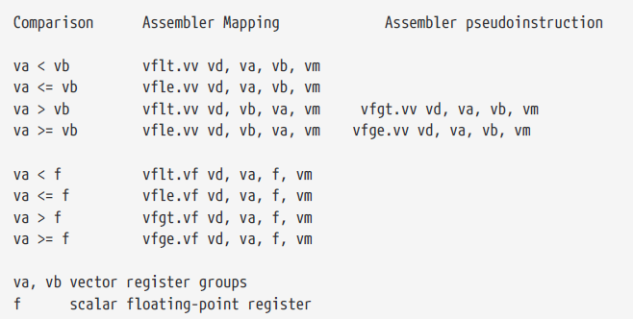
Vector Floating-Point Compare Instructions

Slide 61
Vector Floating-Point Compare Instructions
This feature is removed from RISC-V spec.
To help implement the C99 floating-point comparison functions, a vford instruction is added that sets a mask register if the arguments are ordered.
One of the source operands is treated as NaNs, result should be 0 (unordered).
Vford.vv vd, vs2, vs1, vm # Vector-vector
Vford.vf vd, vs2, rs1, vm # Vector-scalar

Slide 62
Vector Floating-Point MIN/MAX Instructions
Floating-point minimum
Vfmin.vv vd, vs2, vs1, vm #Vector-vector vd[i] = min (vs2[i], vs1[i])
Vfmin.vf vd, vs2, rs1, vm # Vector-scalar vd[i] = min (vs2[i], f[rs1])
Floating-point maximum
Vfmax.vv vd, vs2, vs1, vm # Vector-vector vd[i] = max (vs2[i], vs1[i])
Vfmax.vf vd, vs2, rs1, vm # Vector-scalar vd[i] = max (vs2[i], f[rs1])

Slide 63
FMIN and FMAX Instructions
FMIN-MAX
The rm field indicates MIN/MAX
FMIN: Write the smaller of rs1 and rs2 to rd
FMAX: Write the larger of rs2 and rs2 to rd
The value −0.0 is considered to be less than the value +0.0.
Both inputs are NaNs, the result is the canonical NaN.
Only one operand is a NaN, the result is the non-NaN operand.
Signaling NaN inputs raise the invalid operation exception, even when the result is not NaN.

Slide 64
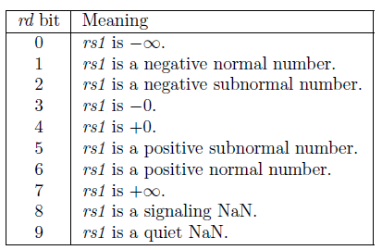
Vector Floating-Point Classify Instruction
Vfclass.v vd, vs2, vm # Vector-vector vd[i] = classify(vs2[i])
The 10-bit mask produced by this instruction is placed in the LSB of the result elements.
This instruction is only defined for SEW=16b above, so the result will always fit in the destination elements.

Slide 65
Vector Floating-Point Merge Instruction
Mask (vm=0):
Vfmerge.vf vd, vs2, rs1, v0.t # vd[i] = v0[i].LSB ? f[rs1] : vs2[i]
All elements should be written back
Unmask (vm=1)
Vfmerge.vf vd, v0, rs1 # vd[i] = f[rs1]
The instruction must have the vs2 field set to v0, with all other values for vs2 reserved.
Pseudo instruction vmv.v.f vd, rs1 which expands to vfmerge.vf vd, v0, rs1

Slide 66
Floating-Point Scalar Move Instructions
The floating-point scalar read/write instructions transfer a single value between a scalar f register and element 0 of as vector register. The instructions ignore LMUL and vector register groups.
Vfmv.f.s rd, vs2 # rd = vs2[0] (rs1=0)
If SEW > FLEN, the least-significant FLEN bits are transferred and the upper SEW-FLEN bits are ignored. If SEW < FLEN, the value is NaN-boxed (1-extended) to FLEN bits.
Vfmv.s.f vd, rs1 # vd[0] = rs1 (vs2=0)
If SEW < FLEN, the least-significant bits are copied and the upper XLEN-SEW bits are ignored. If SEW > FLEN, the value is NaN-boxed (1-extended) to SEW bits.
The other elements in the destination vector register ( 0 < index < VLEN/SEW) are zeroed. If vl=0, no operation is performed and the destination register is not updated.

Slide 67
Backup slides

Slide 68
FMAC Pipeline (subnormal output detection)
Before normalization shifter:
Case1 (EXP>-126): 0.0001xxx*2^100
LZA result (4) for normalization shifter
After normalization 1.xxx*2^96
Case2 (EXP>-126): result 0.0001xxx*2^-125
LZA result (4) for normalization shifter
After normalization 1.xxx*2^-129
Case3 (EXP<-126): result 0.0001xxx*2^-130
LZA result (4) for normalization shifter
After normalization 1.xxx*2^-134

Slide 69
FMAC Pipeline (proposed subnormal output detection)
Example:
Case1: 0.0001xxx*2^100
EXP(100) and (EXP(100) – LZA(4) =96) > -126
Select 4 (LZA result) for normalization shifter
After normalization 1.xxx*2^96
Case2: result 0.0001xxx*2^-125
EXP(-125) > -126 and (EXP(-125) – LZA(4) =-129) < -126
Select 1 (EXP(-125) + 126) for normalization shifter
After normalization 0.001xxx*2^-127
Case3: result 0.0001xxx*2^-127
EXP(-127) < -126
Select 0 for normalization shifter
After normalization 0.0001xxx*2^-127

Slide 70
FMAC Pipeline (subnormal output)
VF2
VF3
VF4
5-bit adder
St1
Sum
Normalization Shifter
<<
4-bit low part adder
5-bit adder
Carry
LZA
St1
sign
rounding mode
Subnorm?
EXP
LSB-adder
Carry and stick Calc.
Round Decision
LSB-adder
LSB-adder
inc
ovf
LSB Correction & special value detection
Dual-adder
Result
Select
decision
EXP result
Result

Slide 71
FMAC Pipeline(proposed subnormal output detection)
VF2
VF3
VF4
Sum
Normalization Shifter
<<
Carry
LZA
EXP-LZA
Subnormal?
EXP
Subnormal
predict
if (EXP < -126)
select 0
else if (EXP-LZA) < -126
select EXP + 126
else
select LZA
adder
126
0
Final EXP?

Slide 72
FMAC Pipeline (subnormal output)
VF2
VF3
VF4
5-bit adder
St1
Sum
Normalization Shifter
<<
4-bit low part adder
5-bit adder
Carry
LZA
St1
sign
rounding mode
Subnorm?
EXP
LSB-adder
Carry and stick Calc.
Round Decision
LSB-adder
LSB-adder
inc
ovf
LSB Correction & special value detection
Dual-adder
Result
Select
decision
EXP result
Result

Slide 73
FMAC Pipeline (proposed subnormal output detection)
Corner case:
Case4: result 0.1111…*2^-127 (maximum subnormal value)
EXP(-127) < -126
Select 0 for normalization shifter
After normalization 0.1111…*2^-127
If the final result‘s (fraction) MSB is 1 (e.g.: 1.0000…) after rounding, it the EXP will be modified from 0 to -126 for 1.0000…*2^-126 (minimum normalization value)

Slide 74
FMAC Pipeline(proposed subnormal output detection)
VF2
VF3
VF4
if (subnormal & Result MSB==0)
select 0
else if (subnormal & Result MSB==1)
select -126
else
select (EXP-LZA)
Sum
Normalization Shifter
<<
Carry
LZA
EXP-LZA
Subnormal
predict
Result MSB
EXP
if (EXP < -126)
select 0
else if (EXP-LZA) < -126
select EXP + 126
else
select LZA
Subnormal
detection
adder
126
0
0
-126
EXP result

